Slide 1

Spring Frame Work

Slide 2
Spring Frame work
Spring Framework
Spring is a lightweight framework. It can be thought of as a framework of frameworks because it provides support to various frameworks such as Struts, Hibernate, Tapestry, EJB, JSF etc. The framework, in broader sense, can be defined as a structure where we find solution of the various technical problems.
The Spring framework comprises several modules such as IOC, AOP, DAO, Context, ORM, WEB MVC etc.
IOC and Dependency Injection
Inversion of Control (IOC) and Dependency Injection (DI) are used interchangeably. IOC is achieved through DI. DI is the process Sof providing the dependencies and IOC is the end result of DI. (Note: DI is not the only way to achieve IOC. There are other ways as well.)
By DI, the responsibility of creating objects is shifted from our application code to the Spring container; this phenomenon is called IOC.
Dependency Injection can be done by setter injection or constructor injection.

Slide 3
Spring Frame work
Spring enables you to build applications from “plain old Java objects” (POJOs) and to apply enterprise services non-invasively to POJOs. This capability applies to the Java SE programming model and to full and partial Java EE.
Examples of how you, as an application developer, can use the Spring platform advantage:
Make a Java method execute in a database transaction without having to deal with transaction APIs.
Make a local Java method a remote procedure without having to deal with remote APIs.
Make a local Java method a management operation without having to deal with JMX APIs.
Make a local Java method a message handler without having to deal with JMS APIs.

Slide 4
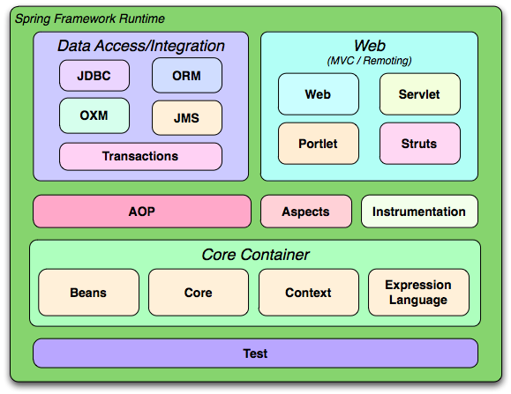

Slide 5
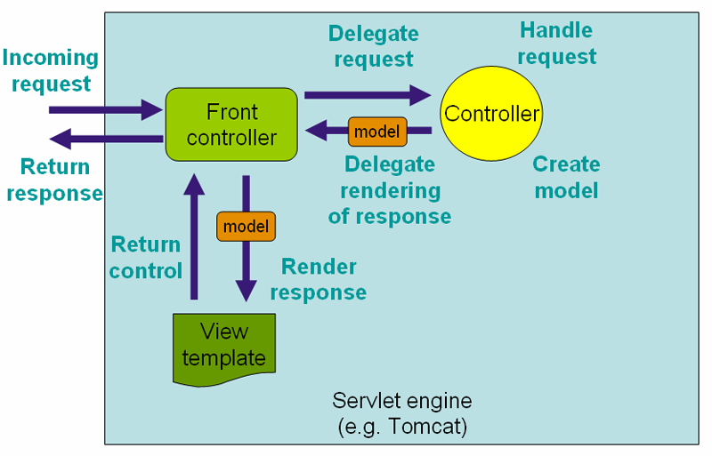
Spring MVC Architecture

Slide 6
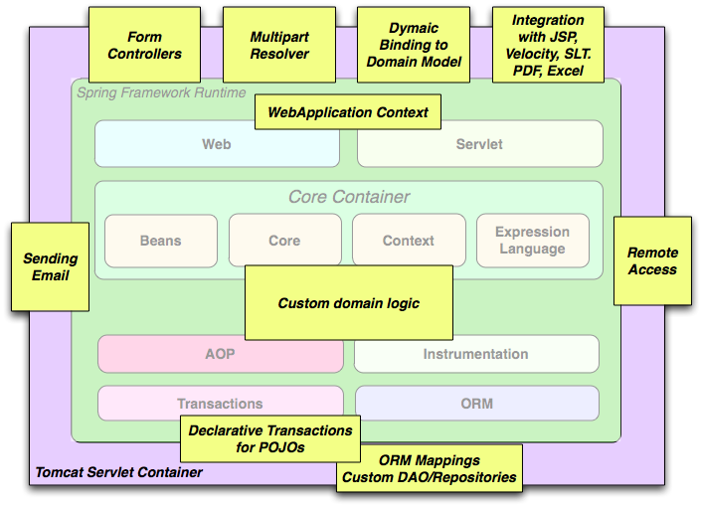

Slide 7
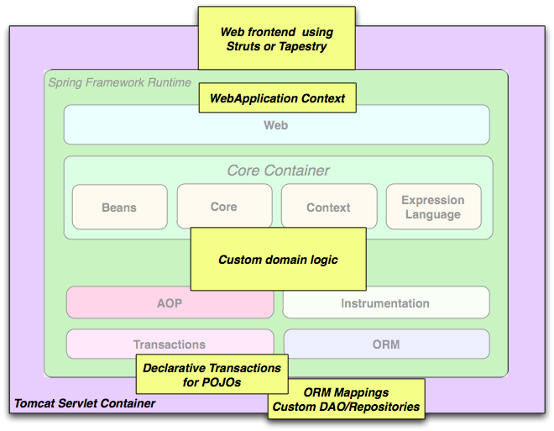

Slide 8
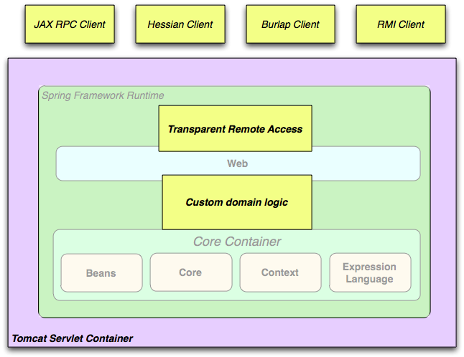

Slide 9
Spring Boot

Slide 10

What is Micro Service?
The main objective of the micro-services implementation is to split up the application as separate service for each core and API service functionality and it should be deployed independently on cloud. We have chosen the reactive programming language from spring.io family project with a set of components that can be used to implement our operations model. Spring Cloud integrates the Netflix components in the spring environment in a very nice way using auto configuration and convention over configuration similar to how Spring Boot works.

Slide 11

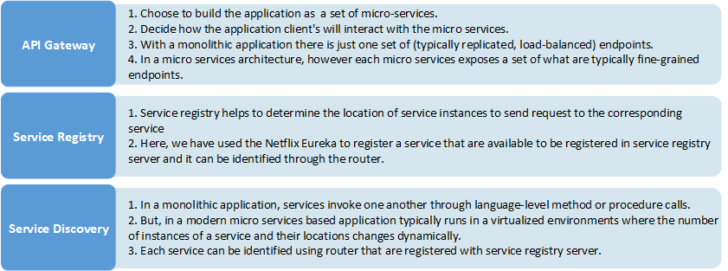
Why Micro Services Architecture?
We chose micro services architecture to write each functionality as a separate service for core and API functionality and it helps us to achieve the continuous delivery and integration.
Patterns in Micro services Architecture

